Slide 1
University of “ESPE”
Advanced web development
Group number 3

Slide 2
TABLE OF CONTENTS
01
03
02
problematic
methodology
Technology

Slide 3
01
Problem

Slide 4



Solution
Problem

Slide 5
02
technologies

Slide 6
used technologies
PHP
Mongodb atlas
Bootstrap
XAMPP
Open Source Language of Programming
Cloud Database
Style Library
Free Software Package

Slide 7
technologies used in frontend
Html
CSS
Bootstrap
Cascading Style Sheets
Library of Style Sheets
Html with language of programming JS

Slide 8

technologies used in backend
XAMP/Apache
PHP
Mongodb atlas
The logic of Project
Database for the medicines
Development Engine of Project

Slide 9
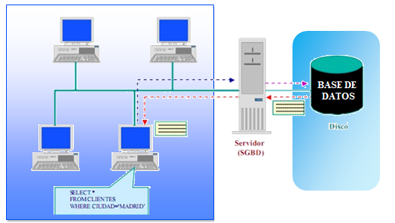
Program architecture
Client
Server
DB

Slide 10
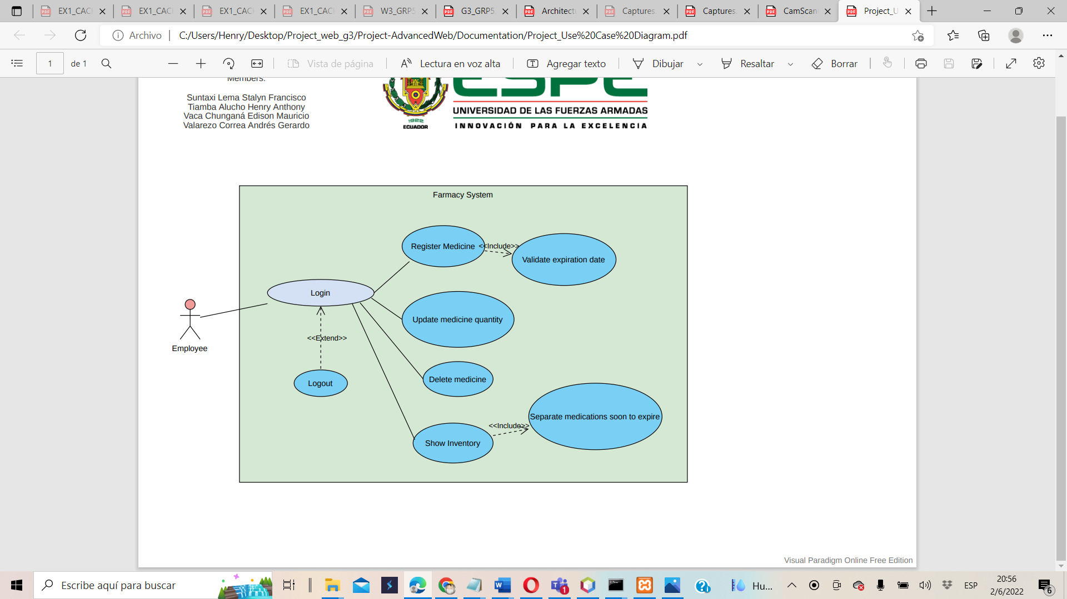
usage diagram

Slide 11
—SOMEONE FAMOUS
use of scrum methodology
“SCRUM is a framework for agile development”

Slide 12




First sprint
* user authentication
* perform the medicines CRUD
*organize medications
*allows entry of medicines
*medication report by category and name
survey of requirements
development planning
we identify the problem
delimitation of requirements(increment one)

Slide 13
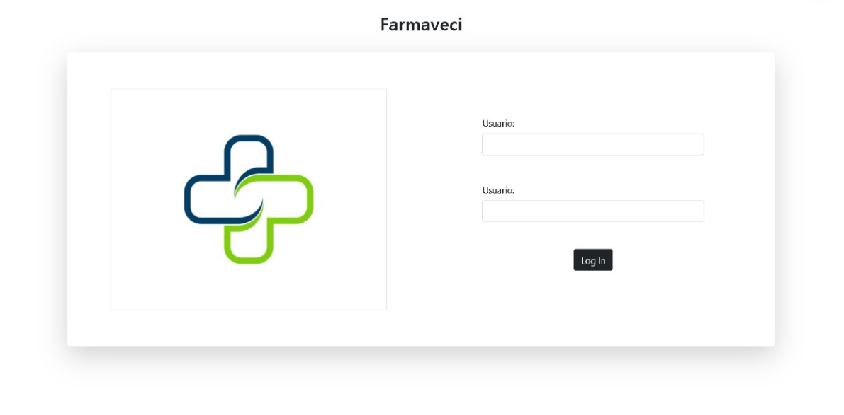
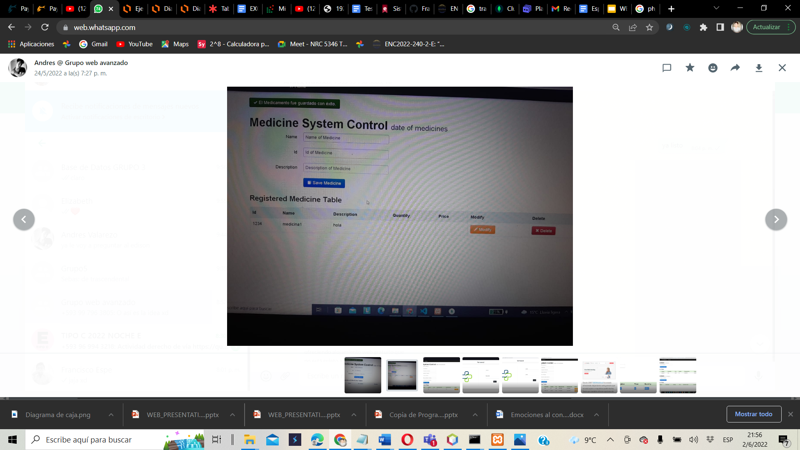


Second sprint
design tests
frontend development
web page design
frontend ready(increment two)

Slide 14
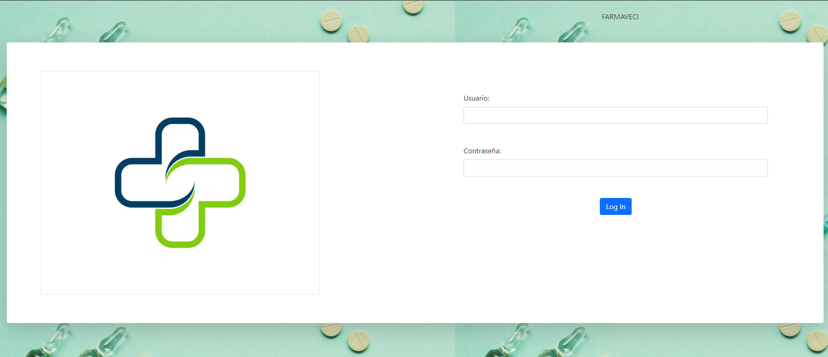
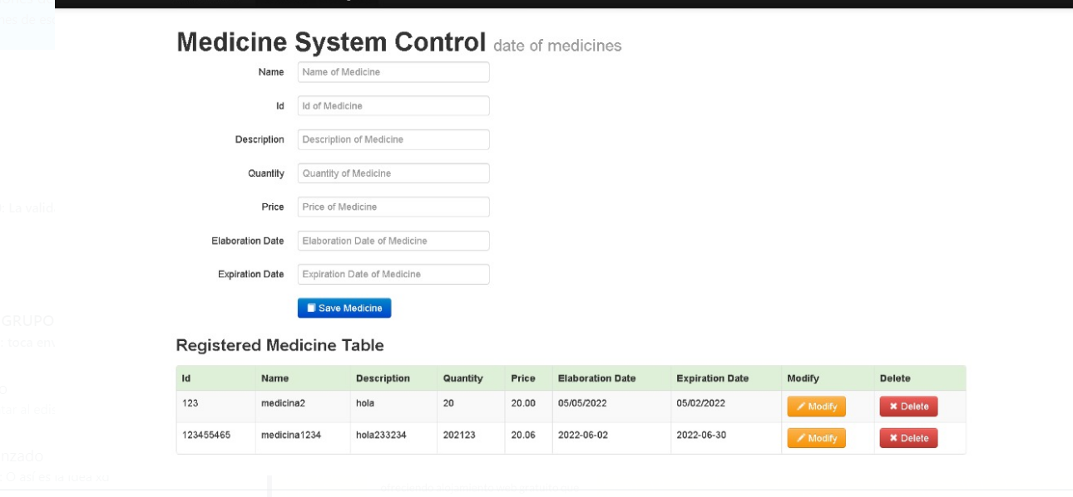
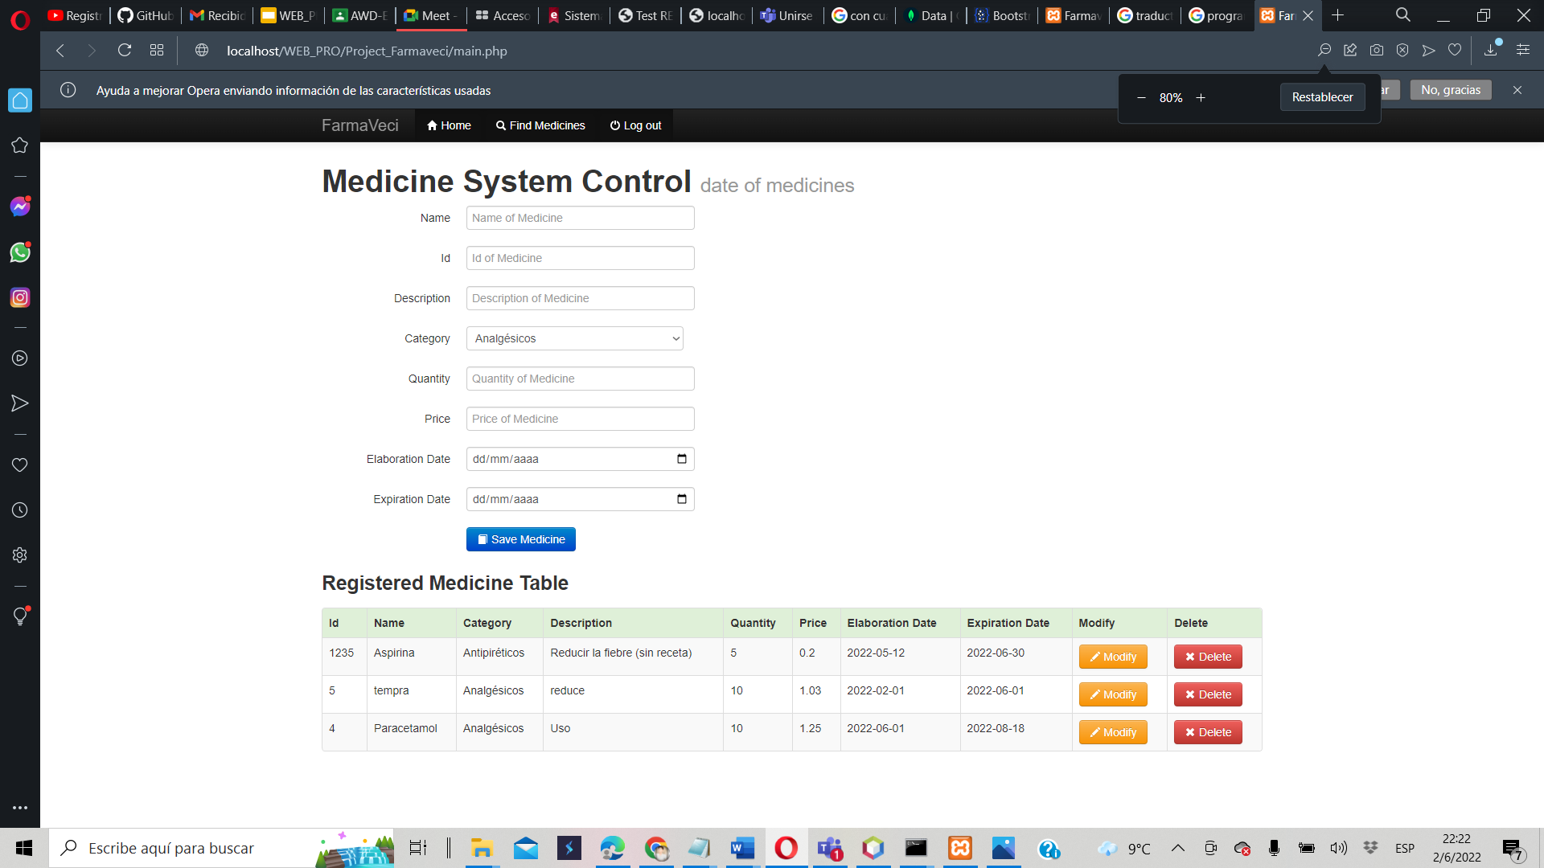
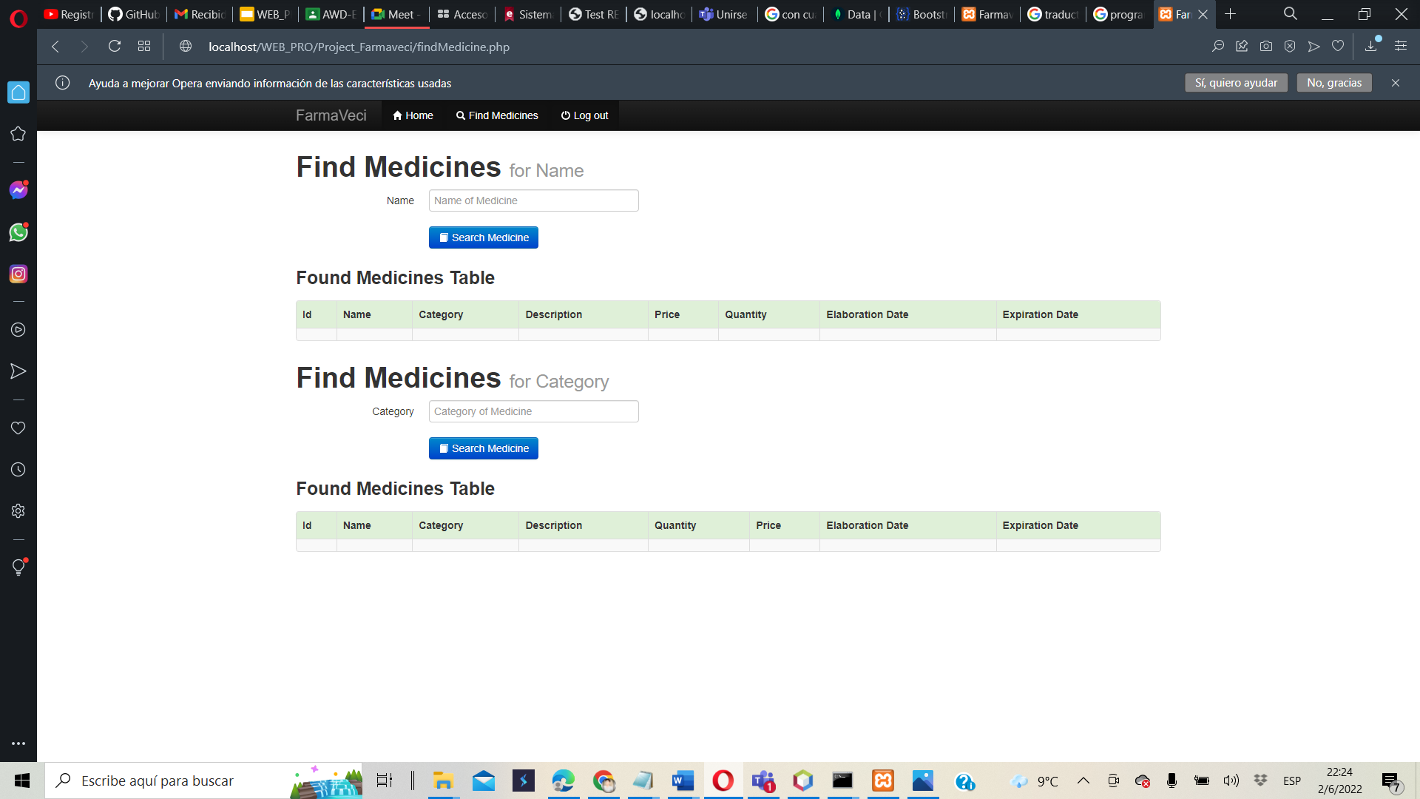
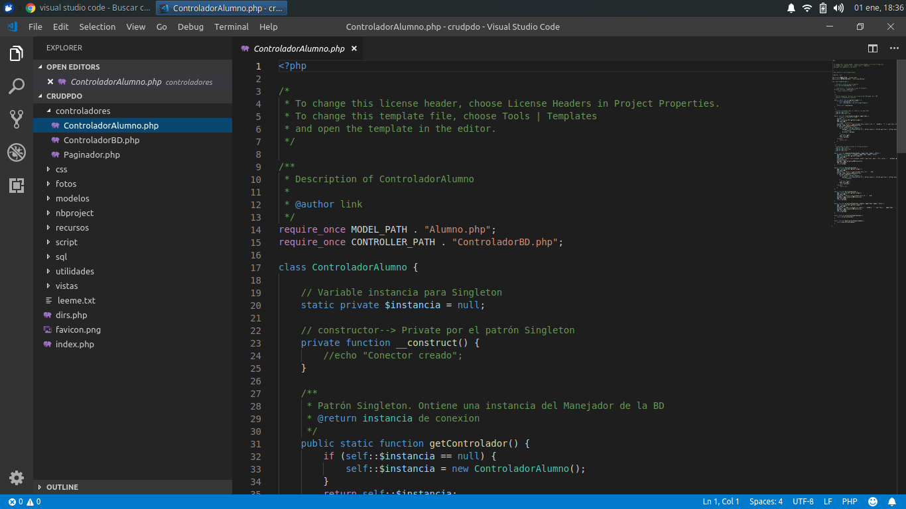
third sprint
front end changes
frontend changes
method test
method development
planning for method development
Increment three

Slide 15
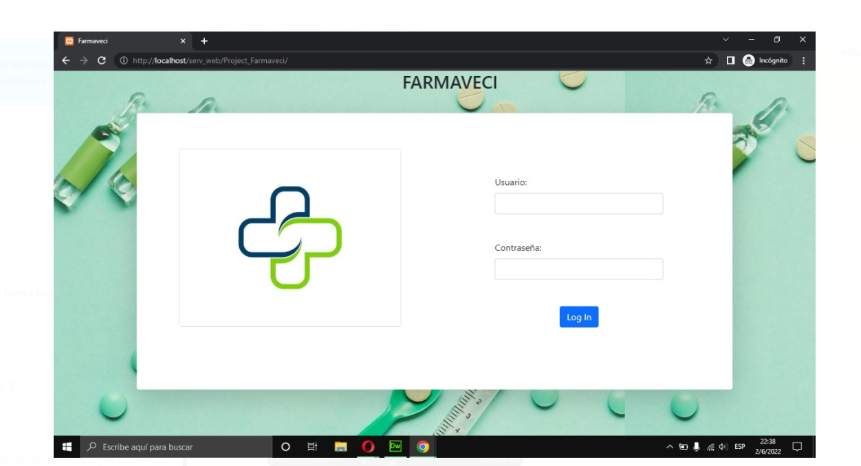
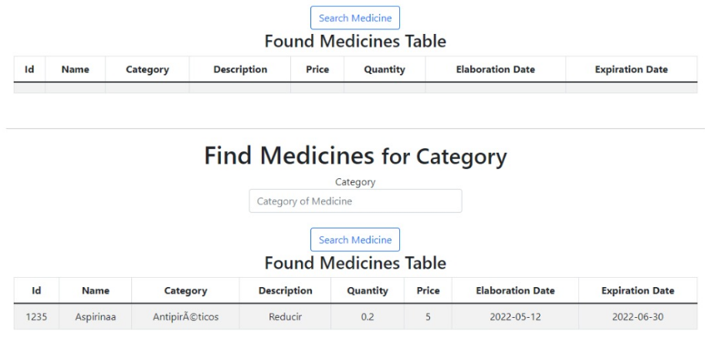
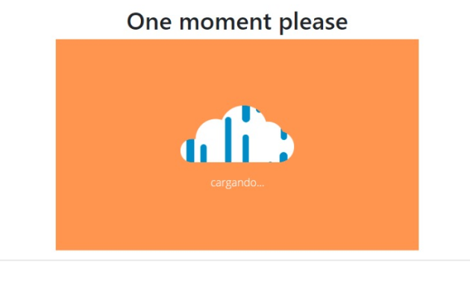
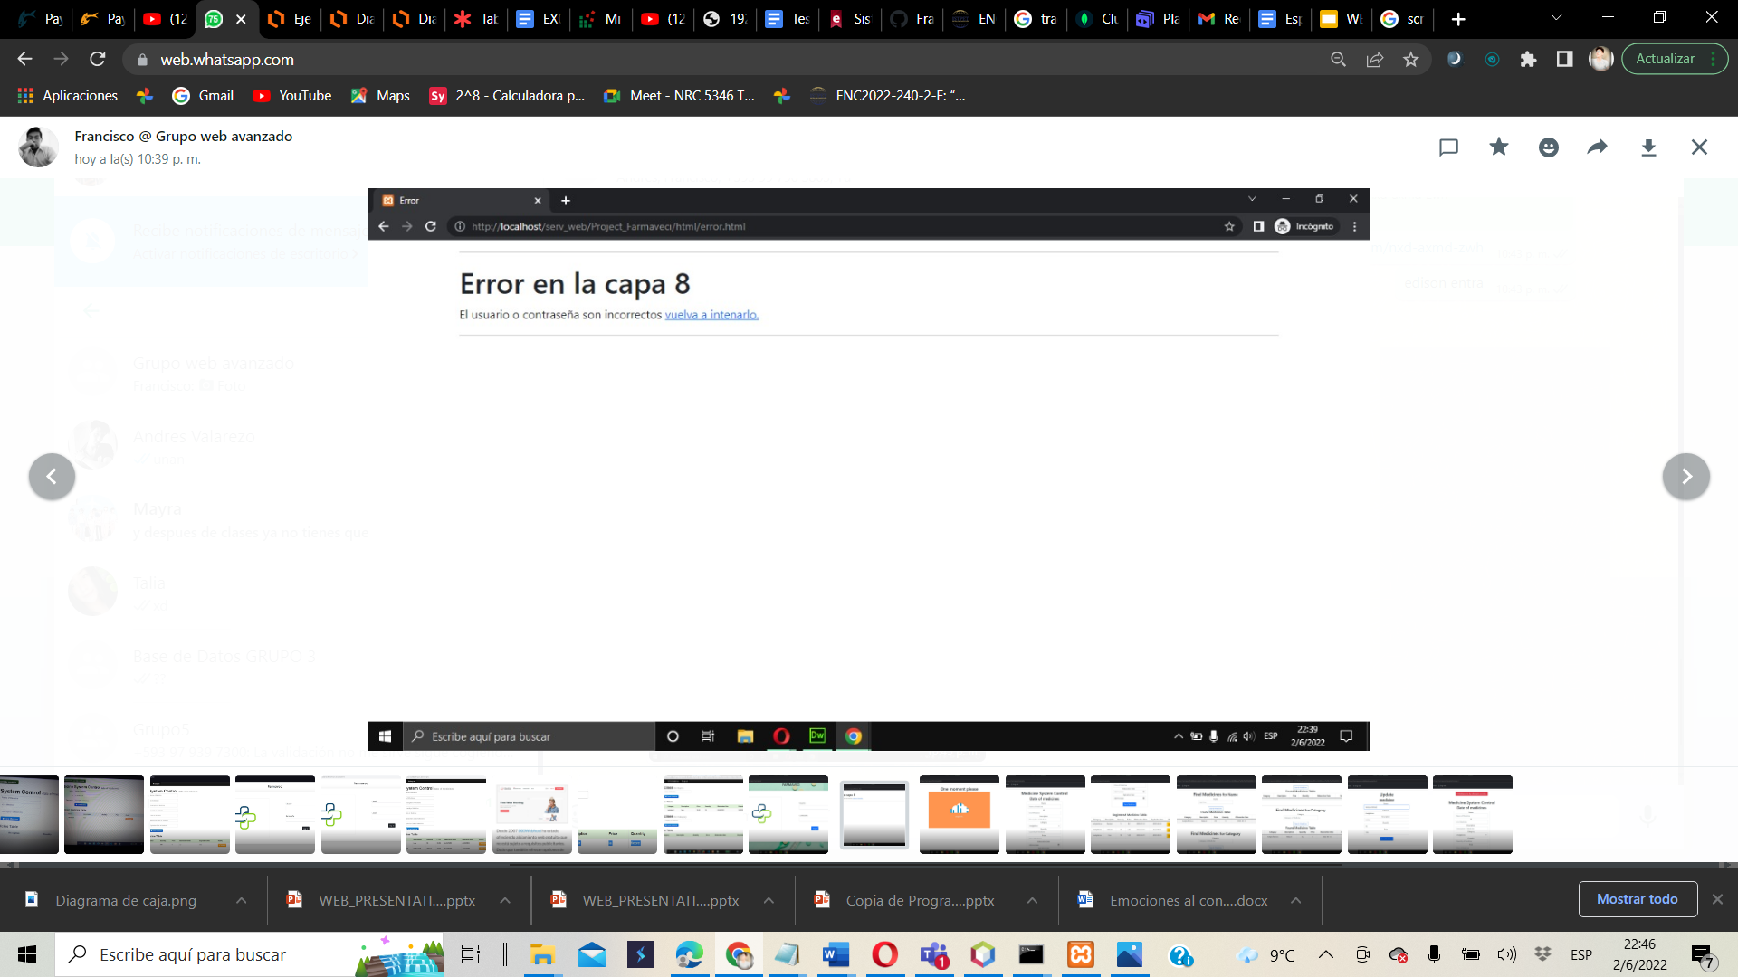
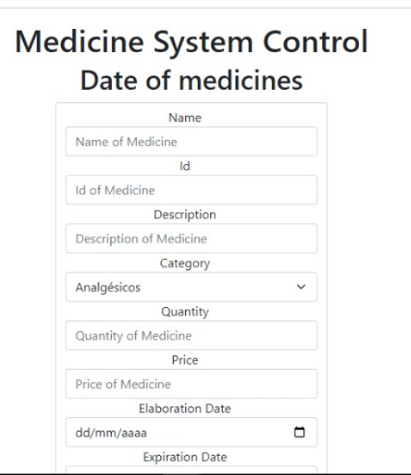
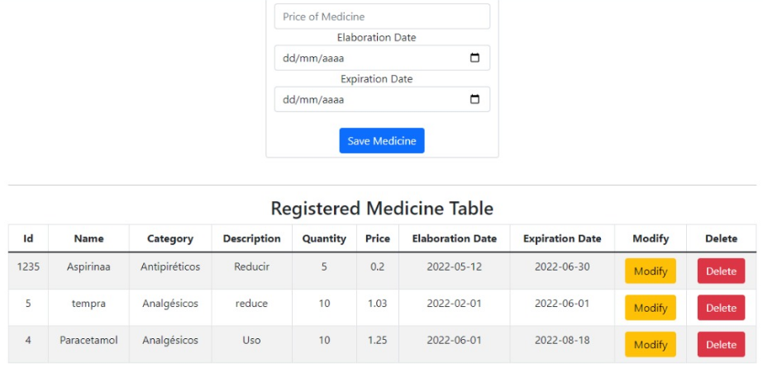
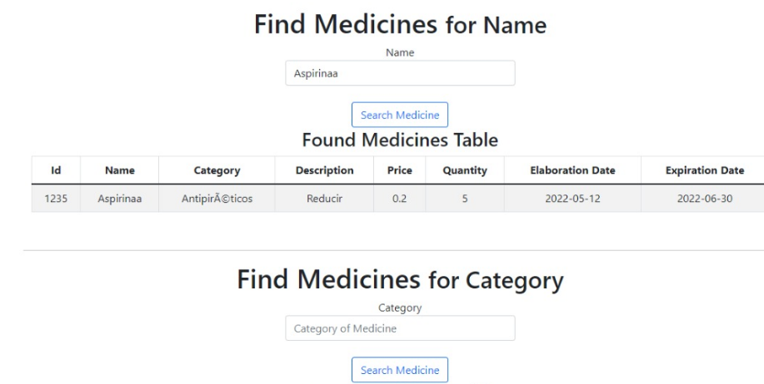
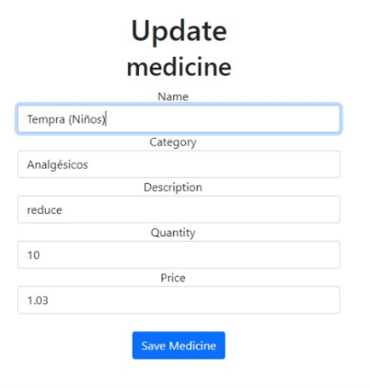
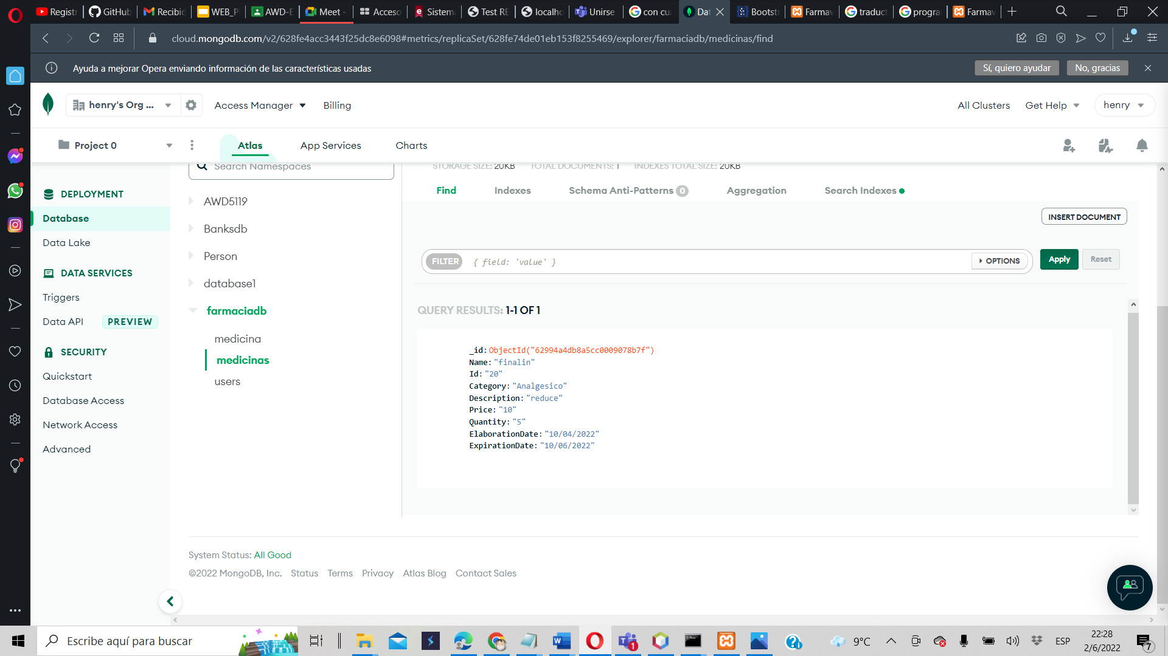
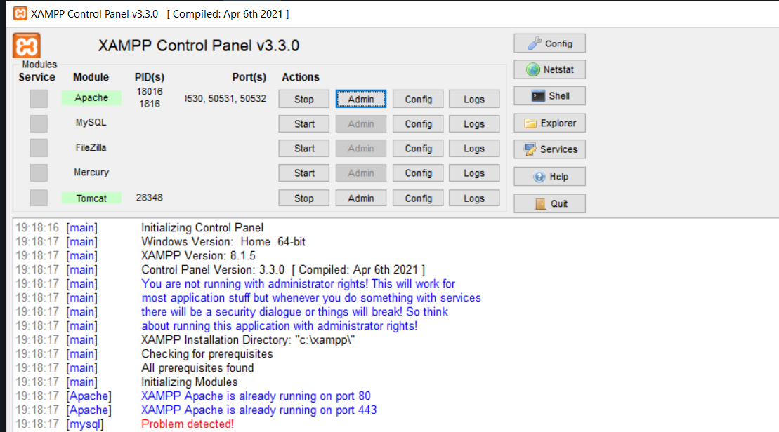
Fourth Sprint
front end changes
increment of a new design
software testing
development of the connection to the cloud and server
team meeting
Software control medicine system

Slide 16
THANKS!
Please, keep this slide for attribution.

